Slide 1

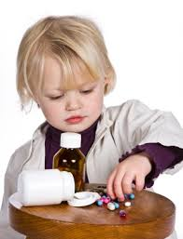
Seeing the Trends
Grey Matter
March-1st-2014

Slide 2
Collect Data
Analysis Data
Decision and Action
Competitive Intelligence
Visualize Data
Catalog Data

Slide 3
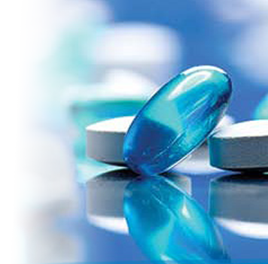
What is the medicine of the future?
Question Today:

Slide 4
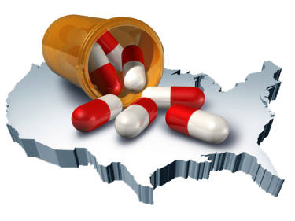
Analysis & Catalog the DATA
Trend in people’s interest
Patent expiration information for future investment
Drug market
Competitor news

Slide 5
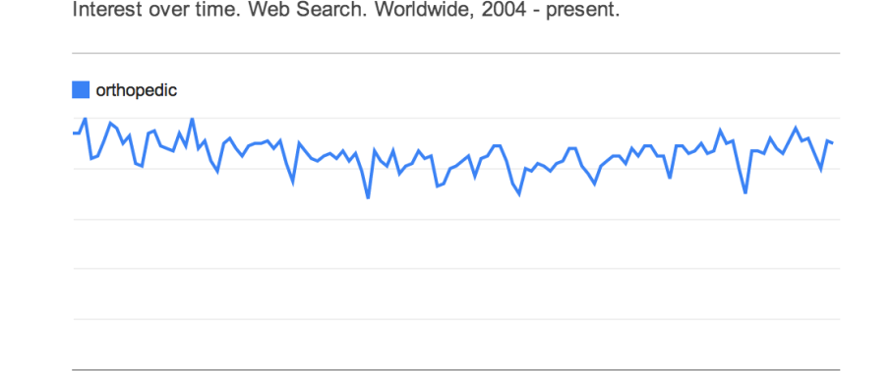
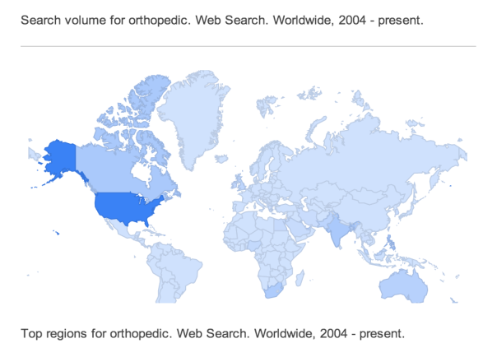
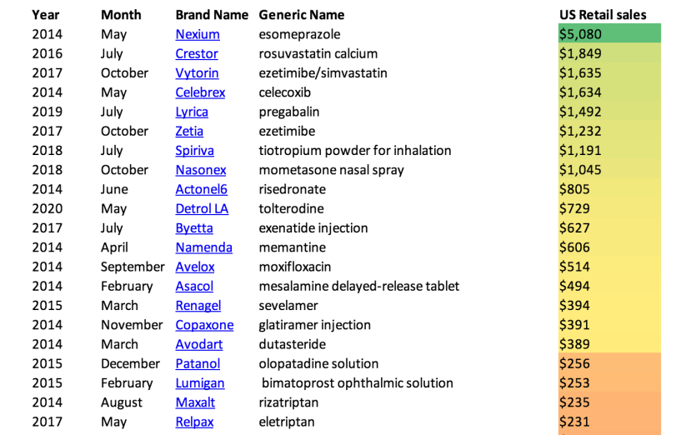
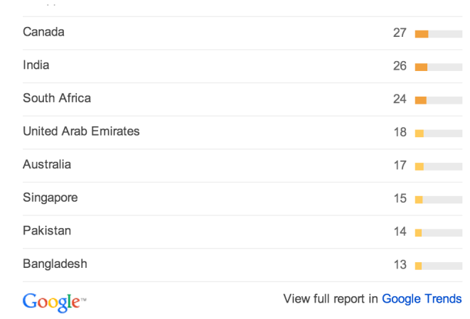
Visualize Data

Slide 6
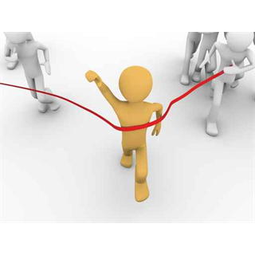
Decision & Action
Born for Win

Slide 7

Find the DATA
www.google.com/trends
Medco Health Solution Inc.
www.marketwatch.com
www.sec.gov
www.fda.gov/

Slide 8
Show Time
Questions
Thank you

